Slide 1
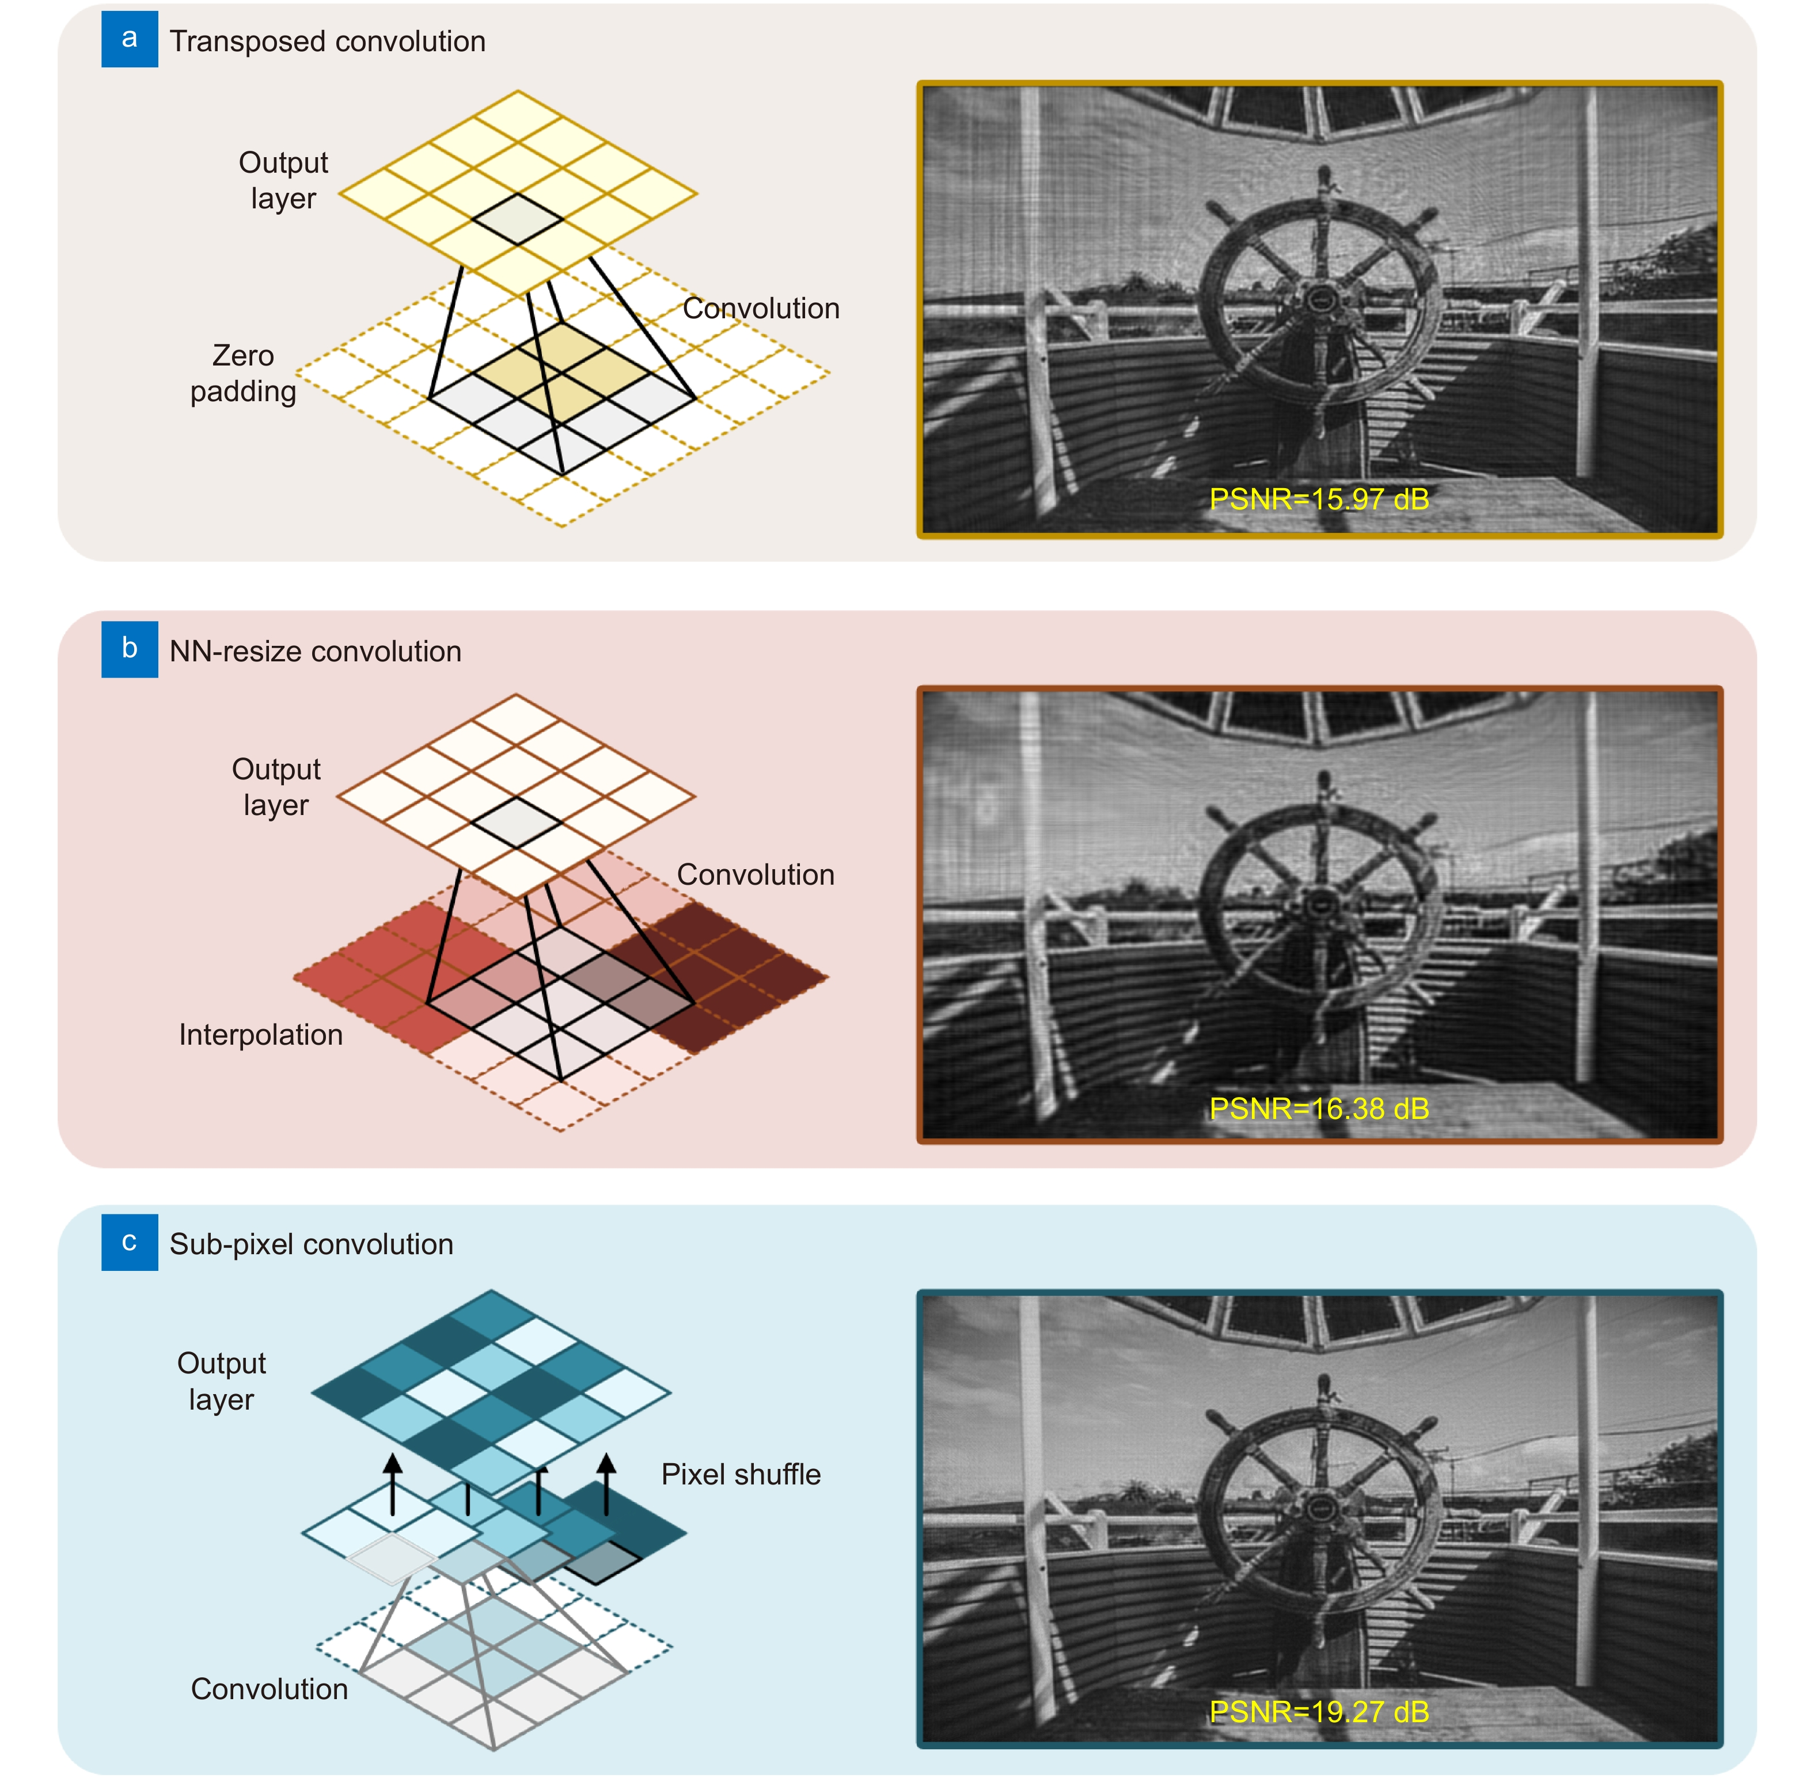
Figure 4. (a–c) Schematic diagram of the transposed convolution, NN-resize convolution, and sub-pixel convolution with their corresponding numerical simulations.
Kexuan Liu,Jiachen Wu,Zehao He,Liangcai Cao
4K-DMDNet: diffraction model-driven network for 4K computer-generated holography
https://doi.org/10.29026/oea.2023.220135

